Slide 1
CSE 340 Computer Architecture Summer 2017 MIPS Arithmetic Review
Notes:
Other handouts
HW#1
To handout next time

Slide 2
Review: MIPS Organization
Processor
Memory
1…1100
src1 addr
5
Register File
src1
data
32
src2 addr
32
registers
($zero - $ra)
5
dst addr
read/write
addr
5
src2
data
write data
32
32
2³⁰
words
32
32 bits
branch offset
read data
32
Add
32
PC
32
Add
32
32
4
32
Fetch
PC = PC+4
32
write data
0…1100
32
0…1000
4
5
6
7
0…0100
32
ALU
0
1
2
3
0…0000
Exec
Decode
32
32 bits
word address
(binary)
32
byte address
(big Endian)

Slide 3
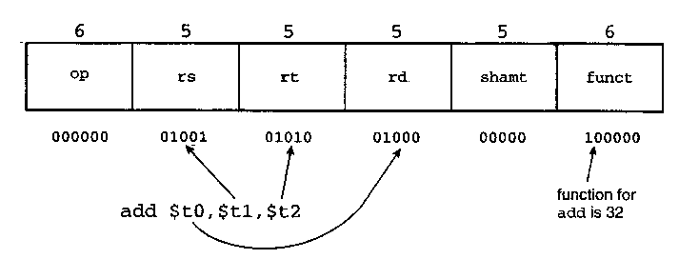
Review: MIPS Addressing Modes
1. Operand: Register addressing
op rs rt rd funct
Register
word operand
The simplest addressing mode is the register addressing. Instructions using registers execute fast because they do not have the delay associated with memory access. But, the number of registers is limited since only 5-bits are reserved to select a register. Register addressing is a form of direct addressing. The value in the register is an operand instead of being a memory address to an operand.

Slide 4
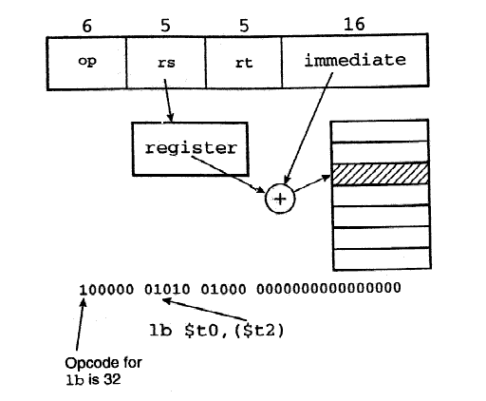
Review: MIPS Addressing Modes
2. Operand: Base addressing
op rs rt offset
Memory
word or byte operand
base register
In base register addressing we add a small constant to a pointer held in a register. The register may point to a structure or some other collection of data, and we need to load a value at a constant offset from the beginning of the structure. Because each MIPS instruction fits in one word, the size of the constant is limited to 16 bits.

Slide 5
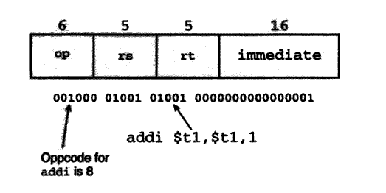
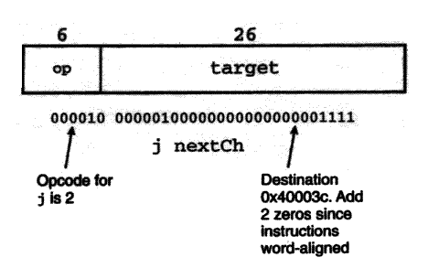
Review: MIPS Addressing Modes
3. Operand: Immediate addressing
op rs rt operand
MIPS immediate addressing means that one operand is a constant within the instruction itself. The advantage of using it is that there is no need to have extra memory access to fetch the operand. But keep in mind that the operand is limited to 16 bits in size.
The jump instruction format can also be considered as an example of immediate addressing, since the destination is held in the instruction.

Slide 6
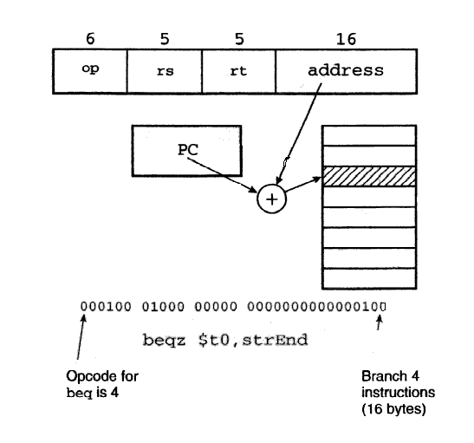
Review: MIPS Addressing Modes
4. Instruction: PC-relative addressing
op rs rt offset
Memory
branch destination instruction
Program Counter (PC)
PC-relative addressing is used for conditional branches. The address is the sum of the program counter and a constant in the instruction. Here is an example to help you understand it.
Beqz = Branch to address/location if the variable = 0

Slide 7
Review: MIPS Addressing Modes
5. Instruction: Pseudo-direct addressing
op jump address
Memory
||
jump destination instruction
Program Counter (PC)

Slide 8
MIPS Number Representations
32-bit signed numbers (2’s complement): 0000 0000 0000 0000 0000 0000 0000 0000_{two} = 0_{ten} 0000 0000 0000 0000 0000 0000 0000 0001_{two} = + 1_{ten} ...
0111 1111 1111 1111 1111 1111 1111 1110_{two} = + 2,147,483,646_{ten} 0111 1111 1111 1111 1111 1111 1111 1111_{two} = + 2,147,483,647_{ten} 1000 0000 0000 0000 0000 0000 0000 0000_{two} = – 2,147,483,648_{ten} 1000 0000 0000 0000 0000 0000 0000 0001_{two} = – 2,147,483,647_{ten} ...
1111 1111 1111 1111 1111 1111 1111 1110_{two} = – 2_{ten} 1111 1111 1111 1111 1111 1111 1111 1111_{two} = – 1_{ten}
maxint
MSB
minint
LSB
Converting <32-bit values into 32-bit values
copy the most significant bit (the sign bit) into the “empty” bits 0010 -> 0000 0010 1010 -> 1111 1010
sign extend versus zero extend (lb vs. lbu)

Slide 9
MIPS Arithmetic Logic Unit (ALU)
Must support the Arithmetic/Logic operations of the ISA
add, addi, addiu, addu
sub, subu, neg
mult, multu, div, divu
sqrt
and, andi, nor, or, ori,
xor, xori
beq, bne, slt, slti, sltiu, sltu
zero
ovf
1
1
A
32
ALU
result
32
B
32
4
m (operation)
With special handling for
sign extend – addi, addiu andi, ori, xori, slti, sltiu
zero extend – lbu, addiu, sltiu
no overflow detected – addu, addiu, subu, multu, divu, sltiu, sltu

Slide 10
Review: 2’s Complement Binary Representation
2’sc binary | decimal
1000 | -8
1001 | -7
1010 | -6
1011 | -5
1100 | -4
1101 | -3
1110 | -2
1111 | -1
0000 | 0
0001 | 1
0010 | 2
0011 | 3
0100 | 4
0101 | 5
0110 | 6
0111 | 7
-2³ =
Negate
-(2³ - 1) =
1011
and add a 1
1010
complement all the bits
2³ - 1 =
Notes:
Signed numbers – assuming 2’s complement representation – for eight bits
Note that msb of 1 indicates a negative number, the bit string all 0’s is zero, that the largest positive number that can be represented is 7 (2**(n-1) –1 for n bits) whereas the largest negative number that can be represented is –8 (-2**(n-1) for n bits)

Slide 11
Overflow Detection
Overflow: the result is too large to represent in 32 bits
Overflow occurs when
adding two positives yields a negative
or, adding two negatives gives a positive
or, subtract a negative from a positive gives a negative
or, subtract a positive from a negative gives a positive
On your own: Prove you can detect overflow by:
Carry into MSB xor Carry out of MSB, ex for 4 bit signed numbers
0
1
1
1
7
1
1
0
0
–4
+
0
0
1
1
3
+
1
0
1
1
– 5
Notes:
For class handout

Slide 12
Overflow Detection
Overflow: the result is too large to represent in 32 bits
Overflow occurs when
adding two positives yields a negative
or, adding two negatives gives a positive
or, subtract a negative from a positive gives a negative
or, subtract a positive from a negative gives a positive
On your own: Prove you can detect overflow by:
Carry into MSB xor Carry out of MSB, ex for 4 bit signed numbers
0
1
1
1
1
0
0
1
1
1
7
1
1
0
0
–4
+
0
0
1
1
3
+
1
0
1
1
– 5
1
0
1
0
– 6
0
1
1
1
7
Notes:
For lecture
Recalled from some earlier slides that the biggest positive number you can represent using 4-bit is 7 and the smallest negative you can represent is negative 8.
So any time your addition results in a number bigger than 7 or less than negative 8, you have an overflow.
Keep in mind is that whenever you try to add two numbers together that have different signs, that is adding a negative number to a positive number, overflow can NOT occur.
Overflow occurs when you to add two positive numbers together and the sum has a negative sign. Or, when you try to add negative numbers together and the sum has a positive sign.
If you spend some time, you can convince yourself that If the Carry into the most significant bit is NOT the same as the Carry coming out of the MSB, you have a overflow.

Slide 13
Tailoring the ALU to the MIPS ISA
Need to support the logic operation (and,nor,or,xor)
Bit wise operations (no carry operation involved)
Need a logic gate for each function, mux to choose the output
Need to support the set-on-less-than instruction (slt)
Use subtraction to determine if (a – b) < 0 (implies a < b)
Copy the sign bit into the low order bit of the result, set remaining result bits to 0
Need to support test for equality (bne, beq)
Again use subtraction: (a - b) = 0 implies a = b
Additional logic to “nor” all result bits together
Immediates are sign extended outside the ALU with wiring (i.e., no logic needed)

Slide 14
Shift Operations
Also need operations to pack and unpack 8-bit characters into 32-bit words
Shifts move all the bits in a word left or right
sll $t2, $s0, 8 #$t2 = $s0 << 8 bits
srl $t2, $s0, 8 #$t2 = $s0 >> 8 bits
op rs rt rd shamt funct
Notice that a 5-bit shamt field is enough to shift a 32-bit value 2⁵ – 1 or 31 bit positions
Such shifts are logical because they fill with zeros
Notes:
also have sllv, srlv, and srav

Slide 15
Shift Operations, con’t
An arithmetic shift (sra) maintain the arithmetic correctness of the shifted value (i.e., a number shifted right one bit should be ½ of its original value; a number shifted left should be 2 times its original value)
so sra uses the most significant bit (sign bit) as the bit shifted in
sra $t2, $s0, 8 #$t2 = $s0 >> 8 bits
The shift operation is implemented by hardware separate from the ALU
using a barrel shifter (which would takes lots of gates in discrete logic, but is pretty easy to implement in VLSI)

Slide 16
Multiply
Binary multiplication is just a bunch of right shifts and adds
n
multiplicand
multiplier
partial
product
array
can be formed in parallel and added in parallel for faster multiplication
n
double precision product
2n

Slide 17
MIPS Multiply Instruction
Multiply produces a double precision product
mult $s0, $s1 # hi||lo = $s0 * $s1
Low-order word of the product is left in processor register lo and the high-order word is left in register hi
Instructions mfhi rd and mflo rd are provided to move the product to (user accessible) registers in the register file
op rs rt rd shamt funct
Multiplies are done by fast, dedicated hardware and are much more complex (and slower) than adders
Hardware dividers are even more complex and even slower;
Notes:
multu – does multiply unsigned
Both multiplies ignore overflow, so its up to the software to check to see if the product is too big to fit into 32 bits. There is no overflow if hi is 0 for multu or the replicated sign of lo for mult.

Slide 18
Division
Division is just a brunch of quotient digit guesses and left shifts and subtracts
n
n
quotient
0
0
0
dividend
divisor
0
partial
remainder
array
0
0
remainder
n

Slide 19
MIPS Divide Instruction
Divide generates the reminder in hi and the quotient in lo
div $s0, $s1 # lo = $s0 / $s1
# hi = $s0 mod $s1
Instructions mfhi rd and mflo rd are provided to move the quotient and reminder to (user accessible) registers in the register file
op rs rt rd shamt funct
As with multiply, divide ignores overflow so software must determine if the quotient is too large. Software must also check the divisor to avoid division by 0.
Notes:
Seems odd to me that the machine doesn’t support a double precision dividend in hi || lo but it looks like it doesn’t

Slide 20
Representing Big (and Small) Numbers
What if we want to encode the approx. age of the earth?
4,600,000,000 or 4.6 x 10⁹
or the weight in kg of one a.m.u. (atomic mass unit)
0.0000000000000000000000000166 or 1.6 x 10⁻²⁷
There is no way we can encode either of the above in a 32-bit integer.
Floating point representation (-1)^{sign} x F x 2E
Still have to fit everything in 32 bits (single precision)
s E (exponent) F (fraction)
1 bit 8 bits 23 bits
The base (2, not 10) is hardwired in the design of the FPALU
More bits in the fraction (F) or the exponent (E) is a trade-off between precision (accuracy of the number) and range (size of the number)
Notes:
Notice that in scientific notation the mantissa is represented in normalized form (no leading zeros)

Slide 21
IEEE 754 FP Standard Encoding
Most (all?) computers these days conform to the IEEE 754 floating point standard (-1)^{sign} x (1+F) x 2^{E-bias}
Formats for both single and double precision
F is stored in normalized form where the msb in the fraction is 1 (so there is no need to store it!) – called the hidden bit
To simplify sorting FP numbers, E comes before F in the word and E is represented in excess (biased) notation
Single Precision |  | Double Precision |  | Object Represented
E (8) | F (23) | E (11) | F (52)
0 | 0 | 0 | 0 | true zero (0)
0 | nonzero | 0 | nonzero | ± denormalized number
± 1-254 | anything | ± 1-2046 | anything | ± floating point number
± 255 | 0 | ± 2047 | 0 | ± infinity
255 | nonzero | 2047 | nonzero | not a number (NaN)
Notes:
Book distinguishes between the representation with the hidden bit there – significand (the 24 bit version) , and the one with the hidden bit removed – fraction (the 23 bit version)

Slide 22
Floating Point Addition
Addition (and subtraction)
(±F1 × 2^{E1}) + (±F2 × 2^{E2}) = ±F3 × 2^{E3}
Step 1: Restore the hidden bit in F1 and in F2
Step 1: Align fractions by right shifting F2 by E1 - E2 positions (assuming E1 ≥ E2) keeping track of (three of) the bits shifted out in a round bit, a guard bit, and a sticky bit
Step 2: Add the resulting F2 to F1 to form F3
Step 3: Normalize F3 (so it is in the form 1.XXXXX …)
If F1 and F2 have the same sign → F3 ∈[1,4) → 1 bit right shift F3 and increment E3
If F1 and F2 have different signs → F3 may require many left shifts each time decrementing E3
Step 4: Round F3 and possibly normalize F3 again
Step 5: Rehide the most significant bit of F3 before storing the result
Notes:
Note that smaller significand is the one shifted (while increasing its exponent until its equal to the larger exponent)
overflow/underflow can occur during addition and during normalization
rounding may lead to overflow/underflow as well

Slide 23
MIPS Floating Point Instructions
MIPS has a separate Floating Point Register File ($f0, $f1, …, $f31) (whose registers are used in pairs for double precision values) with special instructions to load to and store from them
lwcl $f1,54($s2) #$f1 = Memory[$s2+54]
swcl $f1,58($s4) #Memory[$s4+58] = $f1
And supports IEEE 754 single
add.s $f2,$f4,$f6 #$f2 = $f4 + $f6
and double precision operations
add.d $f2,$f4,$f6 #$f2||$f3 = $f4||$f5 + $f6||$f7
similarly for sub.s, sub.d, mul.s, mul.d, div.s, div.d

Slide 24
MIPS Floating Point Instructions, Con’t
And floating point single precision comparison operations
c.x.s $f2,$f4 #if($f2 < $f4) cond=1; else cond=0
where x may be eq, neq, lt, le, gt, ge
and branch operations
bclt 25 #if(cond==1) go to PC+4+25
bclf 25 #if(cond==0) go to PC+4+25
And double precision comparison operations
c.x.d $f2,$f4 #$f2||$f3 < $f4||$f5 cond=1; else cond=0

Slide 25

Next Lecture and Reminders
Next lecture
Addressing and understanding performance
Reading assignment – PH, Chapter 4

